Slide 1
Anger Management
Dr.K.Jafar Ali, Ph.D
CEO, Redefine HR
INDIA

Slide 3
ANGER…. basic human emotion that is experienced by all people
Basic Human emotion , Experienced by all.
Triggered by an emotional hurt.
Completely normal, usually healthy emotion. But when it gets out of control and turns destructive it affects the quality of life.

Slide 4
ANGER
Temporary madness
Losing Self Control Helpless feeling Remote Control is with someone

Slide 5
Anger Right degree ? With Right person ? At Right time ? At Right place ?

Slide 6
How does the body react to anger ?
ADRENALINE and other chemicals pour into the bloodstream.
THE HEART pumps faster.
BLOOD PRESSURE rises.
BLOODFLOW quickens.
MUSCLE tense.
IN OTHER WORDS, the body shifts into higher gear, generating energy needed for action. Learn how this energy can work to your advantage or disadvantage.

Slide 7
It is important to understand anger because the way you express it can be:
HELPFUL: Venting anger can get you “fired up” so you can overcome obstacles and Achieve Goals.
HARMFUL: When you ignore anger or express it in a negative way, it can hurt you and others.

Slide 8
Anger With Self

Slide 9
Anger With Others

Slide 10
Anger With The Almighty

Slide 11
Quran Says : And those who control their anger are friends of Allah. Quran:3/134

Slide 12
Anger Management

Slide 13
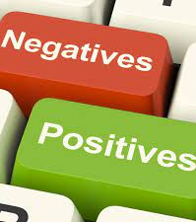
Anger management does not involve getting rid of all anger, but using anger to enhance your life. We can look at the purposes of anger in both a positive and negative light.

Slide 14
The Positive aspects
of anger are that you have increased energy, are able to communicate your feelings, able to solve your problems and can take charge of the situation.

Slide 15
The Negative aspects of anger are that can have disruption
of your thinking, unnecessarily defend yourself, become aggressive and become known as an
angry person.

Slide 16
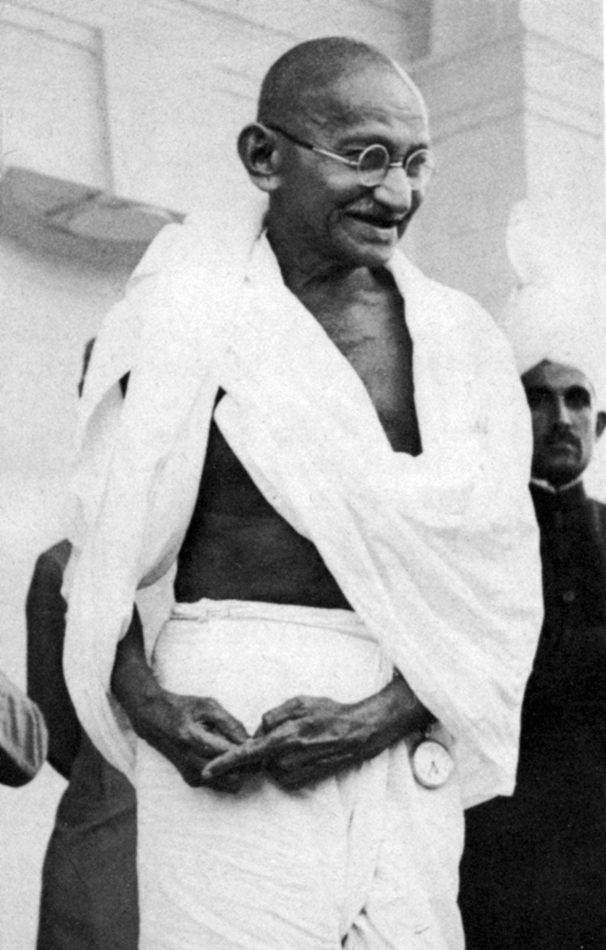
Creative Anger

Slide 17
Time Management & Anger

Slide 18
Life Management & Anger

Slide 19
Reaction vs Response

Slide 20
Reaction Response
An immediate and emotional reply
All about self preservation
You evacuate the situation and slow down
Maintains self control
Comes from a place of love and respect
Long term outlook
Comes from a place of fear
Short term outlook

Slide 21
Reaction Response
An immediate and emotional reply
You evacuate the situation and slow down
All about self preservation
Maintain self control
Comes from a place of fear
Comes from a place of love and respect
Short term outlook
Long term
outlook

Slide 22
Misplaced Anger

Slide 23
Intimacy & Anger

Slide 24
Freedom in bonding

Slide 25
Multiple emotional bonds

Slide 26
Fantasy & Anger

Slide 27
Anger & Domestic Violence

Slide 28
Anger In Married Life

Slide 29
Anger & Human Rights

Slide 30
Anger is a kind of Fear in Anticipation. Anger Is Active Sadness and Sadness is a Passive Anger

Slide 31
A Matchstick has a head but not a brain.

Slide 32
Conquer your Anger

Slide 33
Everyone has the right to be wrong.

Slide 34
Permit people to be what they are in their perception.

Slide 35
Forgiving & Forgetting

Slide 36
Anger & Inner Peace

Slide 37
Accept yourself as you are , Accept others as they are.

Slide 38
EMOTIONAL FIRST AID
Prayer
Meditation
Yoga
Silence

Slide 39
Control your anger before it controls you BECAUSE…

Slide 40
Anger is one letter short of D-A-N-G-E-R

Slide 41
LIVIING LIFE Thoughts Feelings Actions

Slide 42
Anger Management is nothing but Effective Self Management

