Slide 1
Faculty Development Program
“Reach before Teach”
Dr.K.Jafar Ali, Ph.D
CEO, Redefine HR
INDIA

Slide 2
Preach…Teach…Reach…
Students

Slide 3
Gen Y

Slide 4
Gen Y - Advantages
Technological proficiency
Challenging traditional thoughts
Information packed
Multitasking
Non-complacent

Slide 5
Gen Y - Disadvantages
Digitally distracted
Short attention span
Non futuristic
Unrealistically ambitious
Fixated on flexibility

Slide 6
Text and context

Slide 7
Learning, Relearning
and Unlearning

Slide 8
Education enables us to pick up the art of living gracefully with our ignorance.

Slide 9
We don't know what we don't know

Slide 10
The ultimate objective of education is to replace empty mind with an open mind.

Slide 11
Perishable items
Flowers
Milk
Knowledge
Vegetables
Fruits

Slide 12
If you stop learning today, you stop leading tomorrow.

Slide 13
View life as a continuous learning experience.
- Denis Waitley

Slide 14
Living is a treasure that will follow its owner everywhere.
- Chinese Proverb

Slide 15
The ink of the scholar is more sacred than the blood of the martyr.
- Prophet Mohammed.

Slide 16
Live as if you were to die tomorrow. Learn as if you are to live forever.
- Mahatma Gandhi.

Slide 17
Illiterates of 21st century are not those who are not able to read or write but those who are unable to learn, unlearn and relearn.
- Alvin Toffler

Slide 18
Faculty is a co-learner in a learning environment - not a supplier of knowledge and wisdom.

Slide 19
Creativity - conscious escape from routine.

Slide 20
The real voyage of discovery consists not in seeking new lands, but in seeing with new eyes.
- Marcel Proust.

Slide 21
Teaching is the profession that teaches all other professions.

Slide 22
Teaching - A job or career or service or all of them.

Slide 23
“If you wish to achieve worthwhile things in your Personal and career life, you must become a worthwhile person in your own self-development.”
- Brian Tracy.

Slide 24
Matha Pitha
Guru Deivam

Slide 25
Matha Pitha Google Deivam

Slide 26
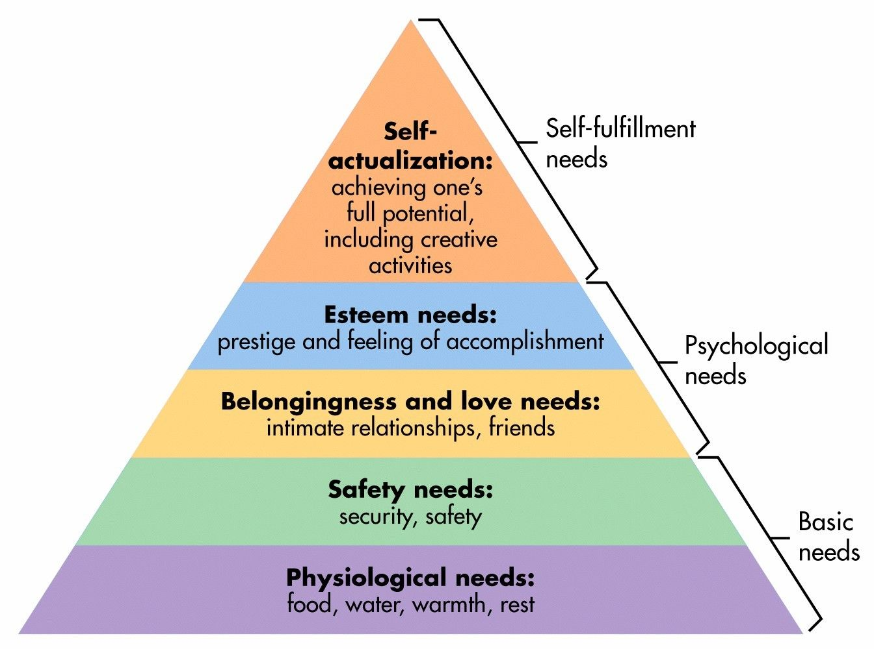
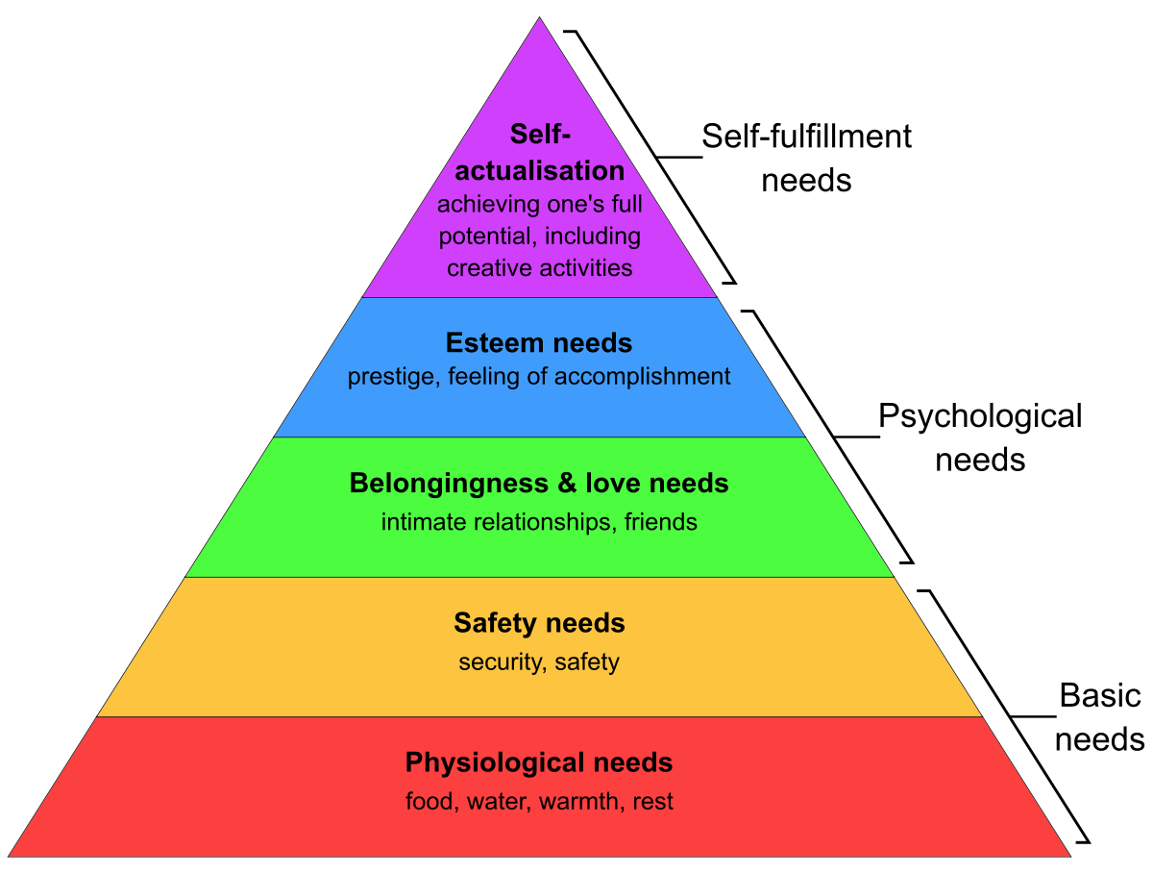
Maslo

Slide 27
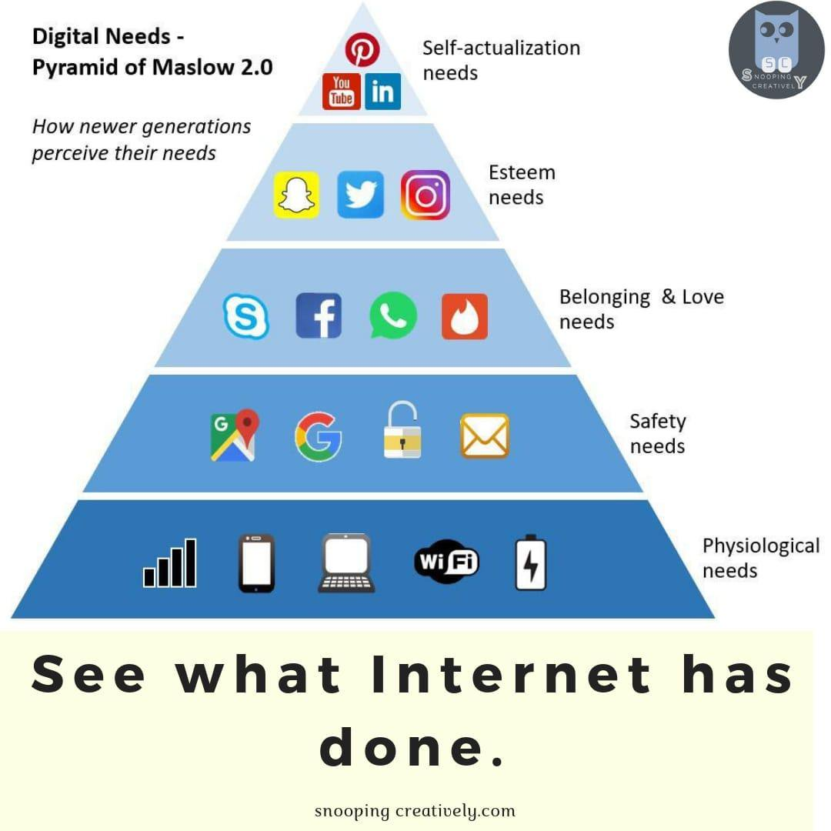

Slide 28
Information
vs
Transformation

Slide 29
Thinking classroom

Slide 30
Tsunami of changes

Slide 31
Learnability

Slide 32
Generation gap

Slide 33
Thank You.

